Slide 1



Touch
Typing
Class V
lab 7

Slide 2


Touch typing
Touch typing is a style of typing without looking at the keys

Slide 3
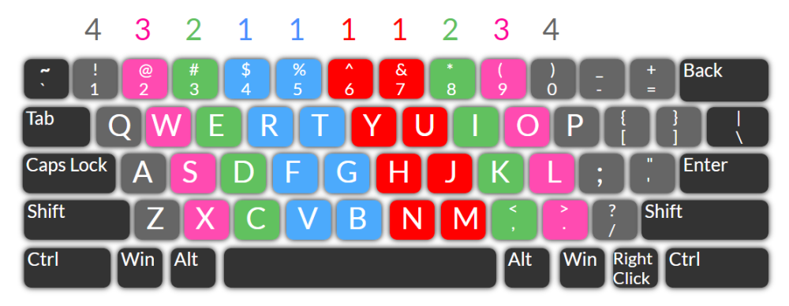
QWERTY keyboard
The name comes from the order of the first six keys on the top left letter row of the keyboard.

Slide 4
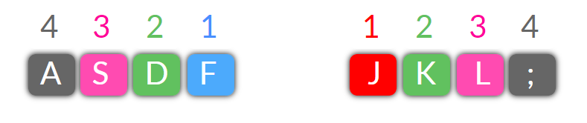
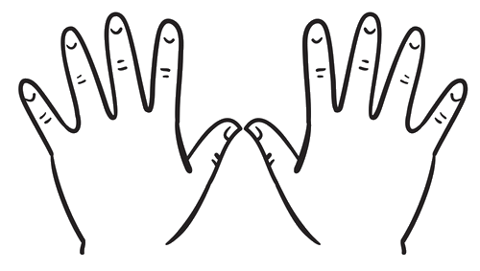
Home Keys
A S D F on the left and J K L ; on the right.

Slide 5
Practise Session
jj kkk lll ;;; jjj kkk lll ;;; jjj kkk lll ;;;jj kk ll ;; jj kk ll ;;
jj kk ll ;; jj kk ll ;; jj k jj l jj ; j k l ; j k l ; jjj kkk ll ;;
jkl; jkl; jkl; jkl; jkl; jkl; jkl; jkl; jkl; jkl; jkl; jkl;

Slide 6


